Slide 1

CSCI – 3308 Software Development Methods and Tools
Lab 2 – Regular Expressions

Slide 2
Regex
A regular expression (regex for short) is a special text string for describing a search pattern.
Used by
grep - “Globally search a Regular Expression and Print”
sed - “Stream Editor”
awk – developed by Alfred Aho, Peter Weinberger, and Brian Kernighan

Slide 3
Atoms in Regex
Specify WHAT text to be matched and WHERE to find this text
Types of Atoms:
Single Character
Dot
Class
Anchor

Slide 4
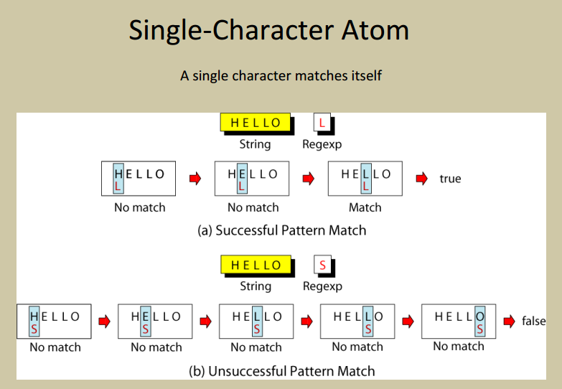

Slide 5
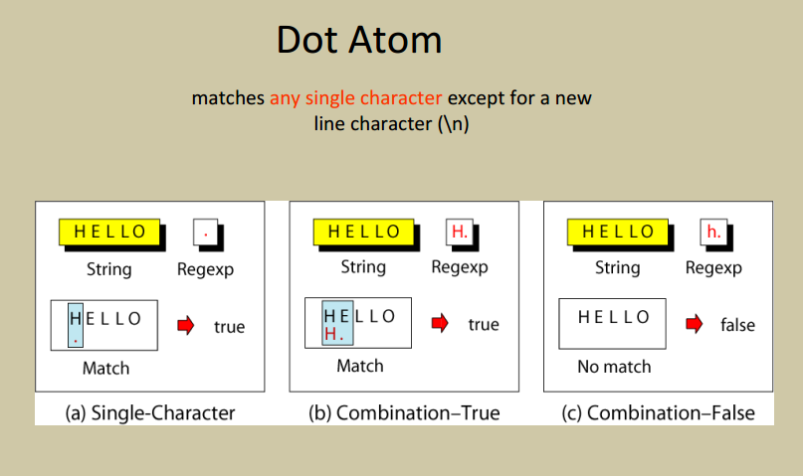

Slide 6
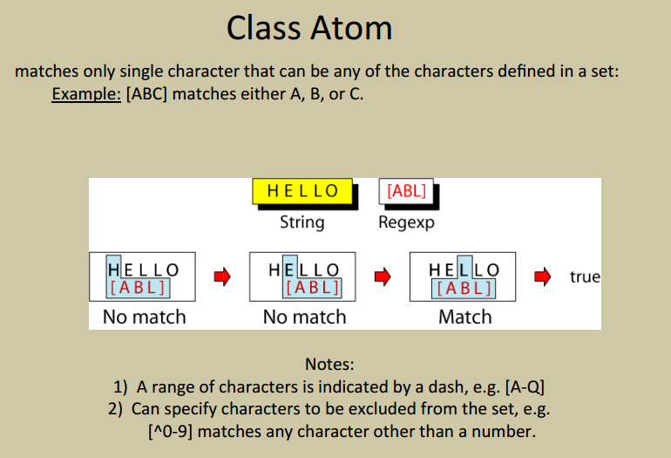

Slide 7
Character Classes
Character classes [ ] can be used to match any specific set of characters.
[abc] - a, b, or c
[a-d] - a, b, c, or d
[^ab] - NOT a or b
b[eor]at
beat a brat on a boat

Slide 8
Character Classes
Character classes [ ] can be used to match any specific set of characters.
[abc] - a, b, or c
[a-d] - a, b, c, or d
[^ab] - NOT a or b
b[eor]at
beat a brat on a boat
beat a brat on a boat

Slide 9
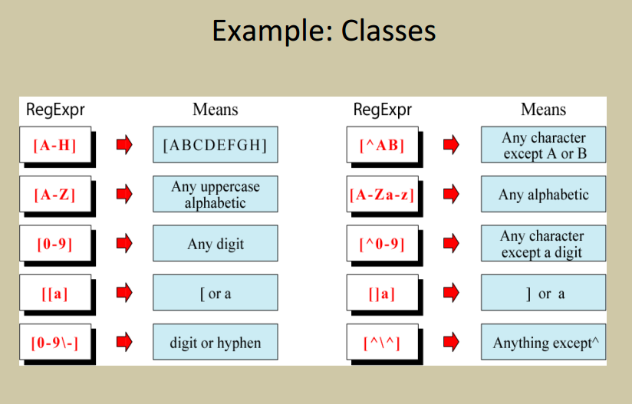

Slide 10
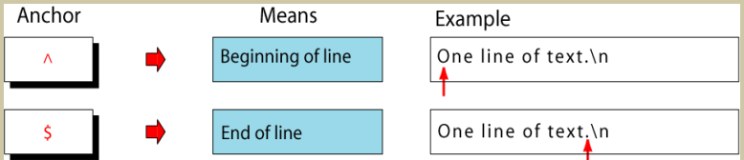
Anchors
Used to match at beginning or end of a line (or both)

Slide 11
Anchors
beat a brat on a boat
What string is chosen with the below anchors?
1) ^b[eor]at
2) b[eor]at$

Slide 12
Anchors
beat a brat on a boat
What string is chosen with the below anchors?
1) ^b[eor]at beat a brat on a boat
2) b[eor]at$ beat a brat on a boat

Slide 13
Group Operator
In the group operator, when a group of characters is enclosed in parentheses, the next operator applies to the whole group, not only the previous characters.
Which string is the correct match for A(BC){ 3 }D
ABCBCBCD
ABCCBCF
ABBCBCBCD

Slide 14
Group Operator
In the group operator, when a group of characters is enclosed in parentheses, the next operator applies to the whole group, not only the previous characters.
Which string is the correct match for A(BC){ 3 }D
ABCBCBCD
ABCCBCF
ABBCBCBCD
{ m , n } -- matches previous character/atom m to n times

Slide 15
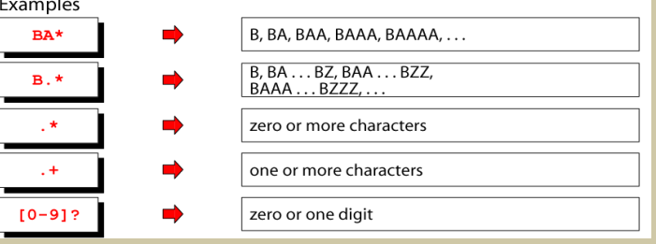
ShortForm Repetition Operators
[ ]* - 0 or more
[ ]+ - 1 or more
[ ]? - 0 or 1

Slide 16
What do these regex do?
[0-9aeiou]$
^[^0-9aeiou]

Slide 17
What do these regex do?
[0-9aeiou]$
Matches if the line ends in a vowel or a number
^[^0-9aeiou]
Matches if the line begins with anything but a vowel or a number

Slide 18
SED
Used for pattern matching and replacement
Enables editing of files without opening vi or emacs
Allows applying same change on multiple files
Syntax:
sed 's/find/replace/' filename
Find the string pattern and replace with another pattern
If replace is left empty, the pattern/element found gets deleted

Slide 19
Exercise
Create file with the below content:
Linux
Solaris
Ubuntu
Fedora
RedHat

Slide 20
Exercise
sed 's/a//' filename => Removed the first occurrence of 'a' in every line of the file
Linux
Solris
Ubuntu
Fedor
RedHt
sed 's/a//g' file => For changes to be reflected globally

Slide 21
Exercise
sed 's/^.//' filename => Removed first character in every line
inux olaris buntu edora edHat

Slide 22
AWK
Searches files containing matching pattern and performs actions on it
Syntax:
awk ‘/search_pattern1/ {Actions}
/search_pattern2/ {Actions}’ filename
search_pattern => Regular Expression
Multiple patterns and actions possible in single awk command

Slide 23
AWK
awk ‘/search_pattern1/ {Actions}
/search_pattern2/ {Actions}’ filename
If pattern not given: AWK performs given Action on each line of the file
If Action not given: AWK prints all lines matching the given pattern
No pattern match == No actions taken
Each line in Actions should be delimited by semicolon

Slide 24
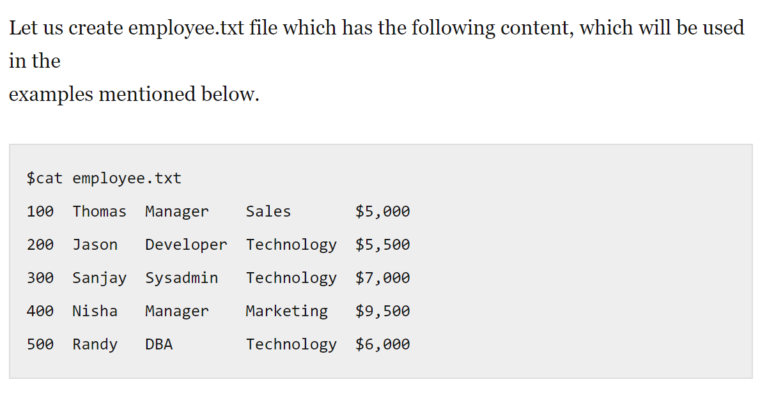

Slide 25
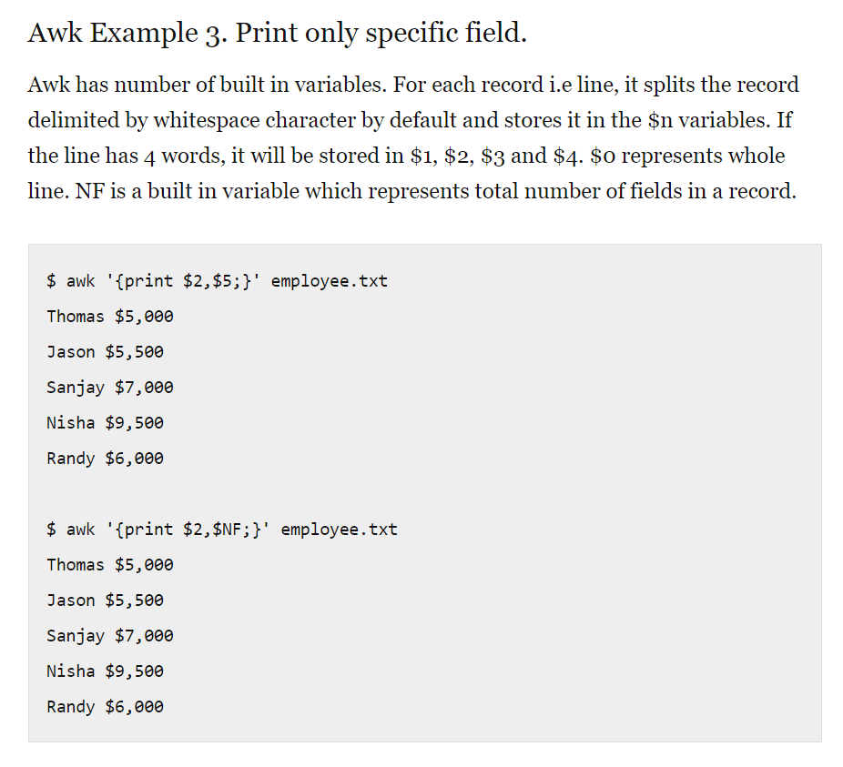

Slide 26
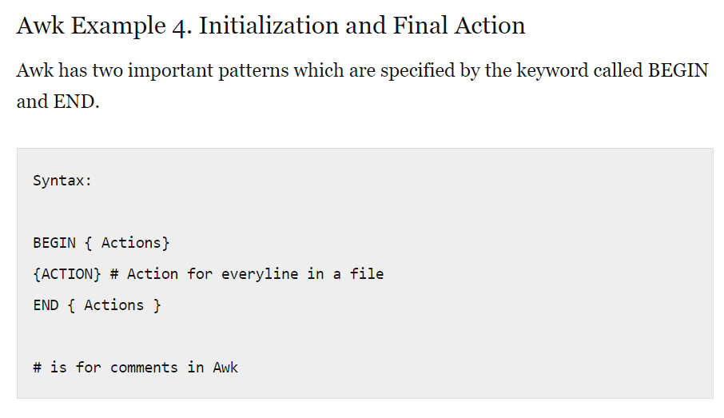

Slide 27
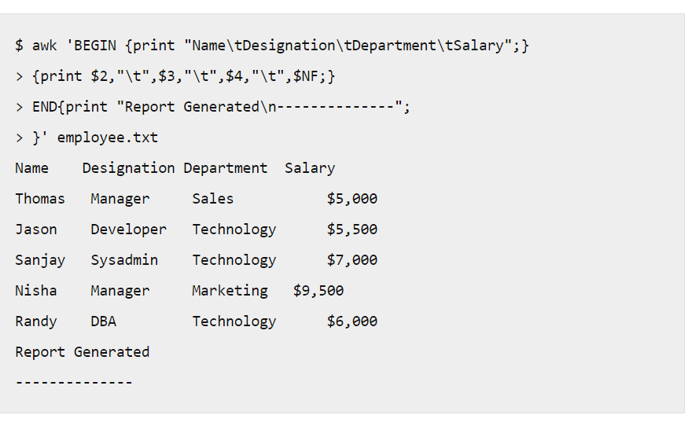

Slide 28
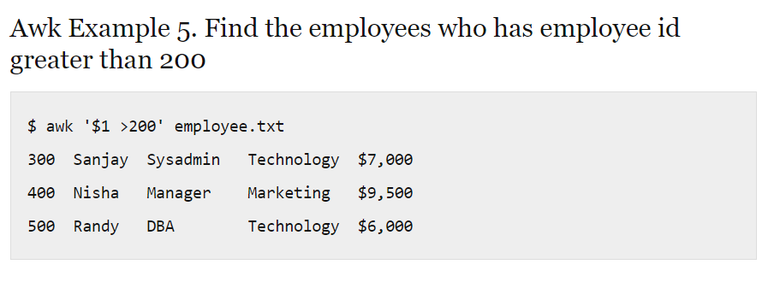

Slide 30
Lets begin the Lab Exercises

